Slide 1

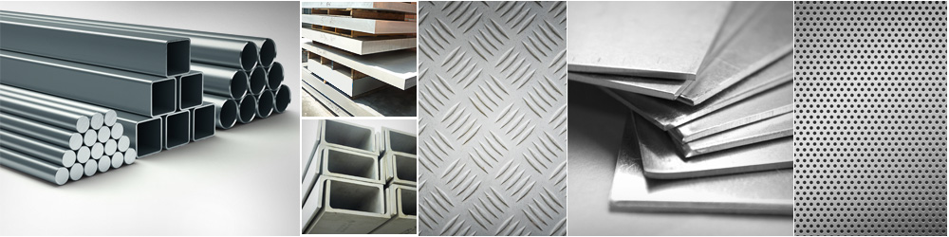
VA METAL PTE LTD
CATALOGUE
SHEET ∞ PLATE ∞ ROD ∞ FLAT BAR ∞ PIPE ∞ U-CHANNEL
PURSUIT OF EXCELLENCE

Slide 2
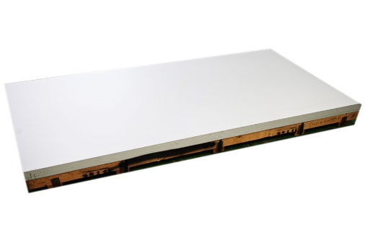
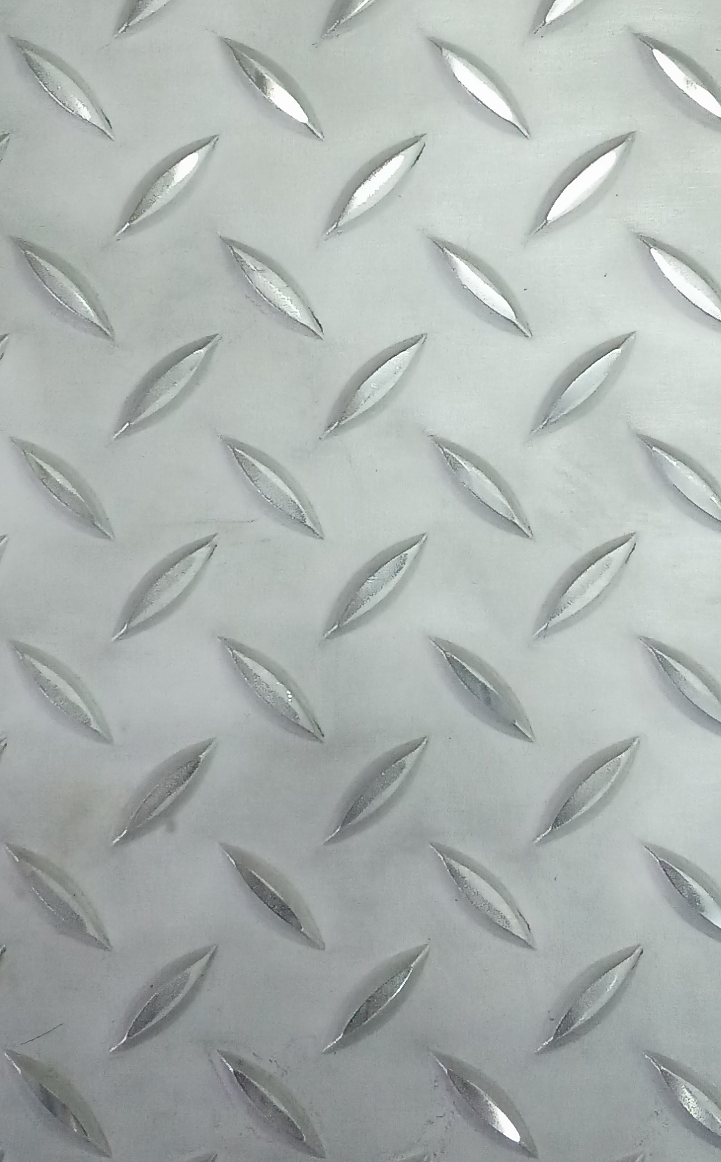


Our Product
Stainless Steel Sheet / Plate
Grade | Thickness | Width x Length
SS304/304L/316/316L No. 1 Finish | 3.0mm to 50mm | 1220mm x 2440mm (4 Ft. x 8 Ft.) 1524mm x 3048mm (5 Ft. x 10 Ft.)
SS304/304L/316/316L 2B Finish | 0.5mm to 6.0mm | 1220mm x 2440mm (4 Ft. x 8 Ft.) 1524mm x 3048mm (5 Ft. x 10 Ft.)
304 4B Finish | 0.5mm to 3.0mm | 1220mm x 2440mm (4 Ft. x 8 Ft.) 1524mm x 3048mm (5 Ft. x 10 Ft.)
304 Hairline (HL) Finish | 0.5mm to 3.0mm | 1220mm x 2440mm (4 Ft. x 8 Ft.) 1524mm x 3048mm (5 Ft. x 10 Ft.)
304 Bright Annealed (BA) Finish | 0.5mm to 3.0mm | 1220mm x 2440mm (4 Ft. x 8 Ft.) 1220mm x 3048mm (4 Ft. x 10 Ft.)
304 No. 8 Finish (Mirror Finish) | 1.0mm to 3.0mm | 1220mm x 2440mm (4 Ft. x 8 Ft.) 1524mm x 3048mm (5 Ft. x 10 Ft.)
Stainless Steel Checkered Plate
Grade | Thickness | Width x Length
304/316/316L | 3.0mm to 6.0mm | 1220mm x 2440mm (4 Ft. x 8 Ft.) 1524mm x 3048mm (5 Ft. x 10 Ft.)
Stainless Steel Perforated Sheet
Grade | Thickness | Hole | Width x Length
304/316/316L | 0.8mm to 6.0mm | 2mm to 13mm | 1220mm x 2440mm (4 Ft. x 8 Ft.)

Slide 3
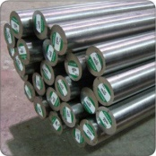
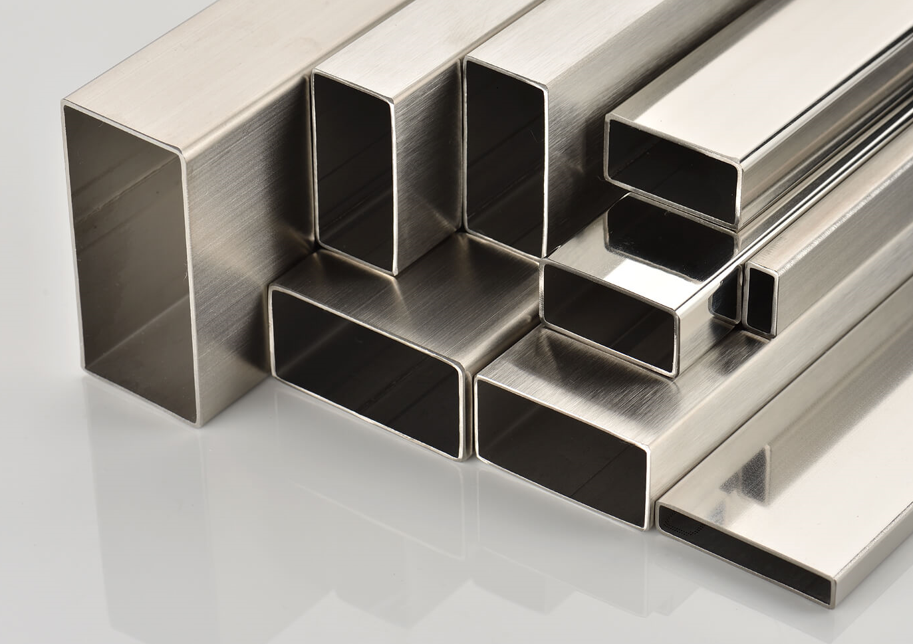
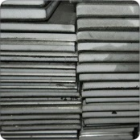
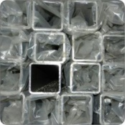
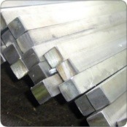
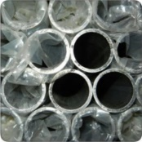
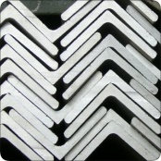
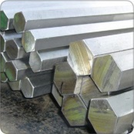
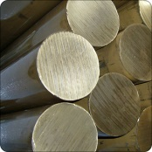
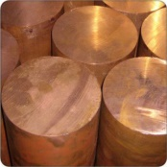
Our Product
Stainless Steel Round Bar
Grade : 304/304L Dimension : Ø 3mm to Ø 12” Size : 2m to 6m long
Grade : 316/316L Dimension : Ø 3mm to Ø 14” Size : 2m to 6m long
Stainless Steel Rectangle Tube
Grade : 304 / 316L Dimension : 12mm x 25mm to 50mm x 100mm Size : 6m long
Stainless Steel Flat Bar
Grade : 304/304L
Dimension : 3mm x 12mm to 2” x 4”
Size : 4m to 6m long
Grade : 316/316L
Dimension : 3mm x 10mm to 1” x 4”
Size : 4m to 6m long
Stainless Steel Square Tube
Grade : 304 / 316L Dimension : 1/2” Sq to 5” Sq Size : 6m long
Stainless Steel Square Bar
Grade : 304/304L Dimension : 1/8” Sq to 4” Sq Size : 12ft to 4m long
Grade : 316/316L Dimension : 1” Sq to 3” Sq Size : 12ft to 4m long
Stainless Steel Round Tube
Grade : 304 / 316L Dimension : OD 1/4” to OD 4” Size : 6m long
Stainless Steel Angle Bar
Grade : 304/304L & 316/316L Dimension : 3mm x 20mm to 9mm x 100mm Size : 6m long
Stainless Steel Hexagon Bar
Grade : 304
Dimension : AF 12.7mm to AF 50.8mm
Size : 12ft to 6m long
Grade : 316/316L
Dimension : AF 12.7mm to AF 50.8mm
Size : 6m long
Brass Round Bar
Grade : JIS H3250 C3604 (ROHS-COMPLY) Dimension : Ø 1/8″ to Ø 8″ Size : 1m to 12ft long
Copper Round Bar
Grade : JIS H3250 C1100 (ROHS-COMPLY) Dimension : Ø 1/8” to Ø 6” Size : 6ft to 12ft long

Slide 4
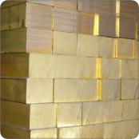
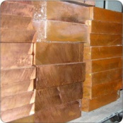
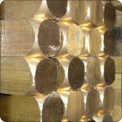
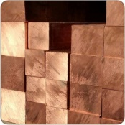
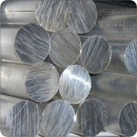
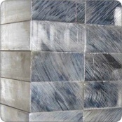
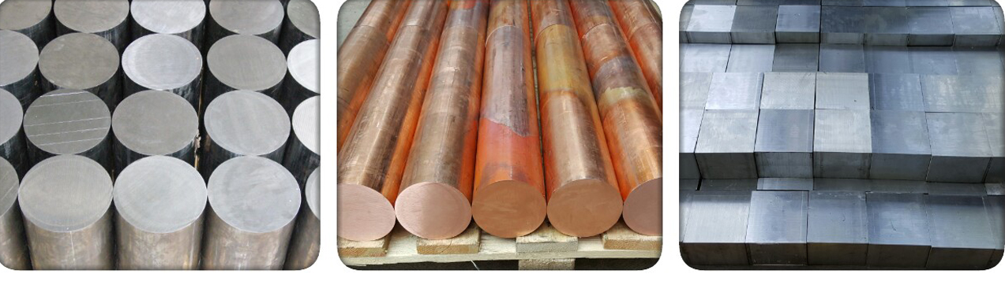
Our Product
Brass Flat Bar
Grade : JIS H3250 C3604 (ROHS-COMPLY) Dimension : 1/8” x 1/4” to 2” x 6” Size : 1m to 12ft long
Copper Flat Bar
Grade : JIS H3250 C1100 (ROHS-COMPLY) Dimension : 3mm x 12mm to 4” x 14” Size : 12ft to 6m long
Brass Square Bar
Grade : JIS H3250 C3604 (ROHS-COMPLY) Dimension : 1/8″ Sq to 4″ Sq Size : 1m to 12ft long
Copper Square Bar
Grade : JIS H3250 C1100 (ROHS-COMPLY) Dimension : 1/4” Sq to 4” Sq Size : 8ft to 12ft long
Aluminium Round Bar
Grade : 6061-T6 Dimension : Ø 1/4” to Ø 16” Size : 8ft to 6m long
Aluminium Flat Bar
Grade : 6061-T6 Dimension : 1/8” x 1/2” to 2” x 4” Size : 12ft to 20ft long
Our work is driven
by our values

Slide 5
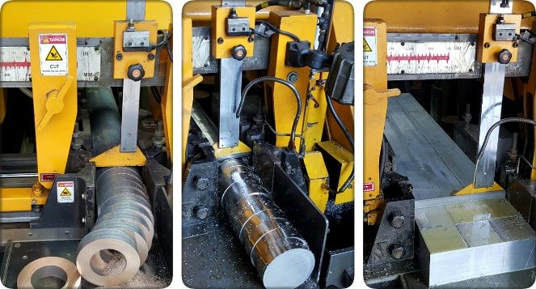
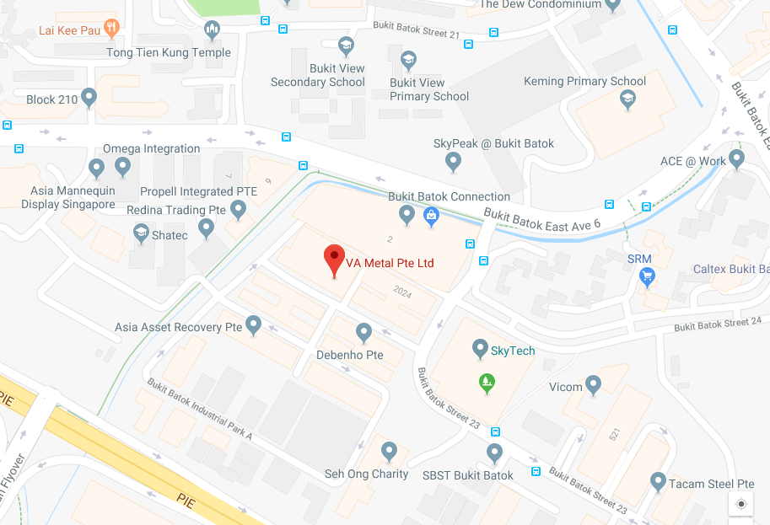
Services
Bandsaw Cutting
VA Metal provides Band Saw & Plasma cutting as a basic service to our customers. Based on your requirements we are able to cut to length the various products that we stock
Contact Information
Contact Us
Locate Us
VA METAL PTE LTD Blk 2023, #01-92,St 23, Bukit Batok Ind. Park A, Singapore 659528. Tel: 6561 6619, 6563 5537 Fax: 6560 1041
Email : James@vametal.com.sg
Email : Peter@vametal.com.sg

